Slide 1



Analyze Faces and Forms with Azure AI Computer Vision
CIS-5850 (Fall 2021): Group Project

Slide 2






CIS5850 - Project Team
Vijay
Muthupillai
Santhi
Vijai
Kato
Chant
Siying
Chen
Fred
Far

Slide 3


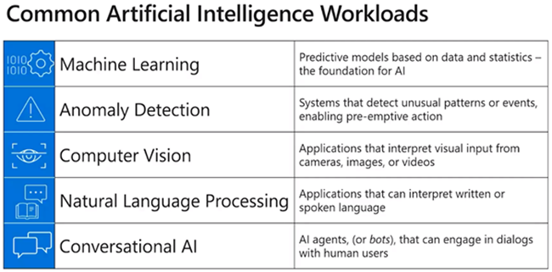
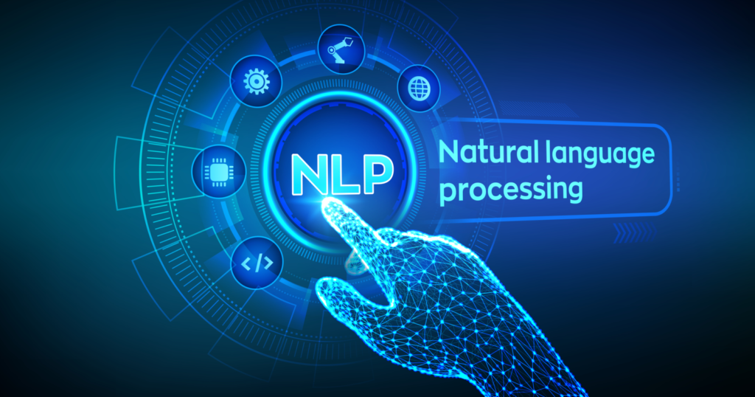

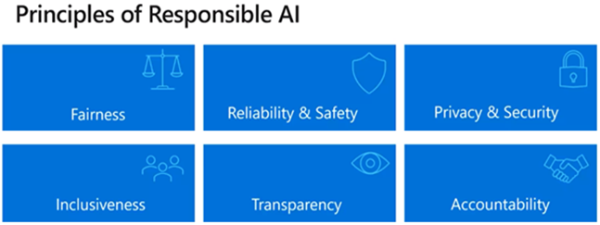
AI in Azure- Introduction

Slide 4
AI Computer Vision - Introduction
Computer vision is an area of artificial intelligence (AI) in which software systems are designed to perceive the world visually, though cameras, images, and video.
Computer Vision models and capabilities
Computer vision services in Microsoft Azure
Task | Description
Image classification | Image classification involves training a machine learning model to classify images based on their contents. For example, in a traffic monitoring solution you might use an image classification model to classify images based on the type of vehicle they contain, such as taxis, buses, cyclists, and so on.
Object detection | Object detection machine learning models are trained to classify individual objects within an image, and identify their location with a bounding box. For example, a traffic monitoring solution might use object detection to identify the location of different classes of vehicle.
Semantic segmentation | Semantic segmentation is an advanced machine learning technique in which individual pixels in the image are classified according to the object to which they belong. For example, a traffic monitoring solution might overlay traffic images with "mask" layers to highlight different vehicles using specific colors.
Image analysis | You can create solutions that combine machine learning models with advanced image analysis techniques to extract information from images, including "tags" that could help catalog the image or even descriptive captions that summarize the scene shown in the image.
Face detection, analysis, and recognition | Face detection is a specialized form of object detection that locates human faces in an image. This can be combined with classification and facial geometry analysis techniques to infer details such as age and emotional state; and even recognize individuals based on their facial features.
Optical character recognition (OCR) | Optical character recognition is a technique used to detect and read text in images. You can use OCR to read text in photographs (for example, road signs or store fronts) or to extract information from scanned documents such as letters, invoices, or forms.
Service | Capabilities
Computer Vision | You can use this service to analyze images and video, and extract descriptions, tags, objects, and text.
Custom Vision | Use this service to train custom image classification and object detection models using your own images.
Face | The Face service enables you to build face detection and facial recognition solutions.
OCR | Designed for quick extraction of small amounts of text in images. It operates synchronously to provide immediate results.
READ | better option for scanned documents that have a lot of text and works asynchronously
Form Recognizer | Use this service to extract information from scanned forms and invoices.
Citation:
Understand computer vision - Learn | Microsoft Docs

Slide 5
AI Computer Vision – Project Scope
Facial detection and Analysis:
Help consumers requiring assistance
Evaluate customer satisfaction
Extract Text from Receipt/Invoice Image:
Read store receipts using Form recognition
Competitive market research
Handle Claims/Promotions and Rebates

Slide 6
Analyze Face from an Image – using Azure FACE Api
There are 4 steps to demonstrate “Facial Analysis from an Image".
1. Create a “FACE Api” from Cognitive Service resource in Azure.
2. Run Azure PowerShell in Cloud.
3. Download Python Project from GitHub.
4. Configure FACE Api reference and run the Python Program.

Slide 7
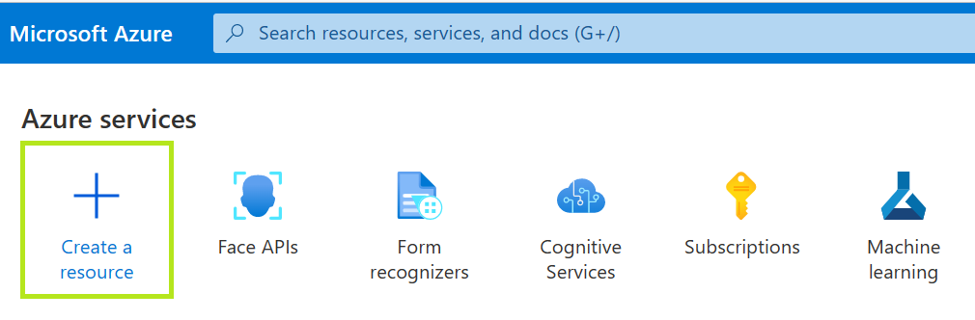
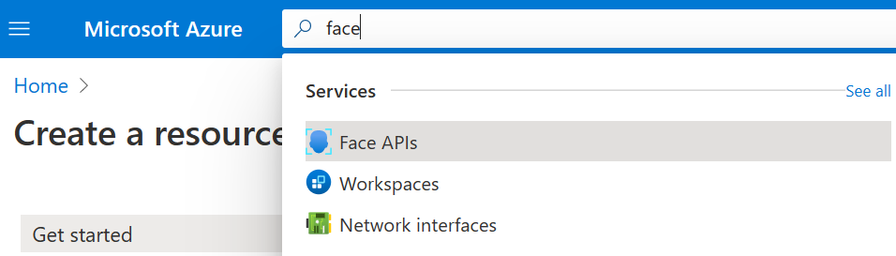
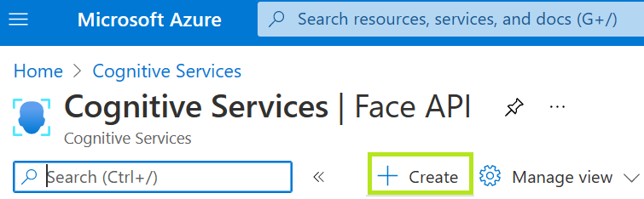
Analyze Face from an Image – Azure FACE Api creation

Slide 8
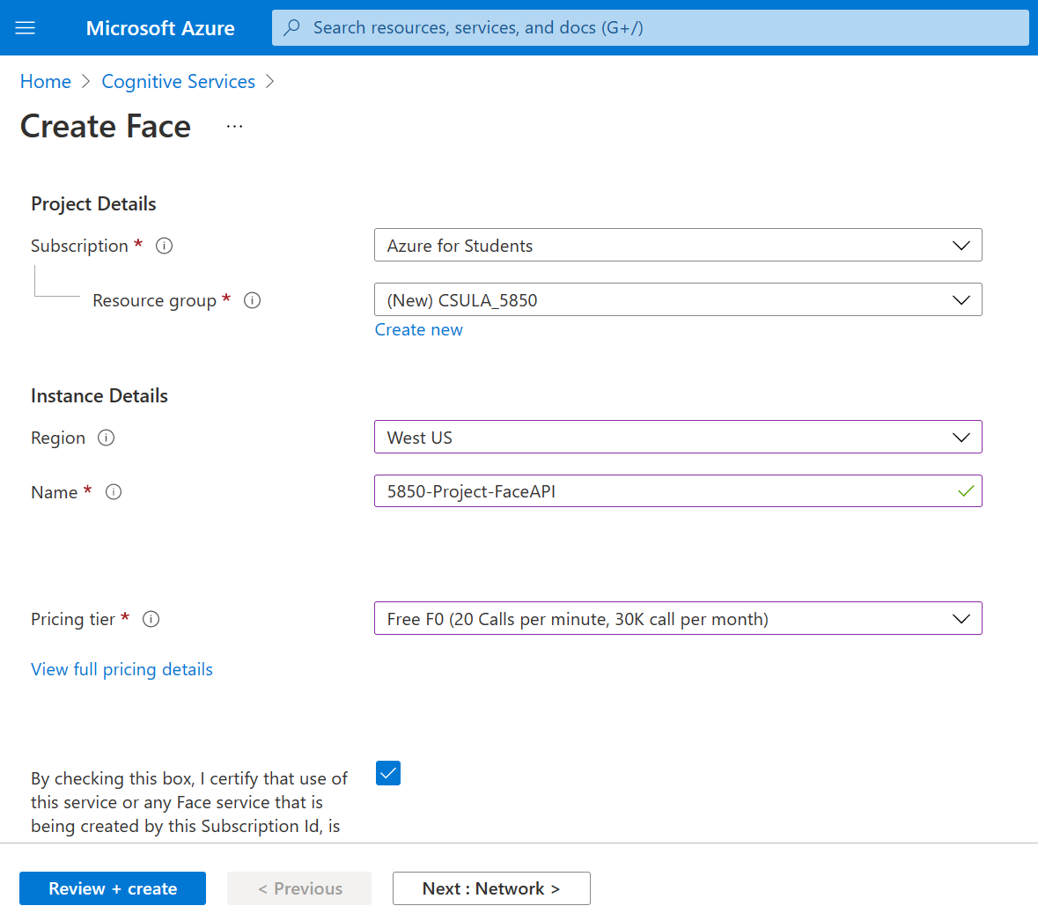
Azure Cognitive Service – Create FACE Api (Continued..)

Slide 9
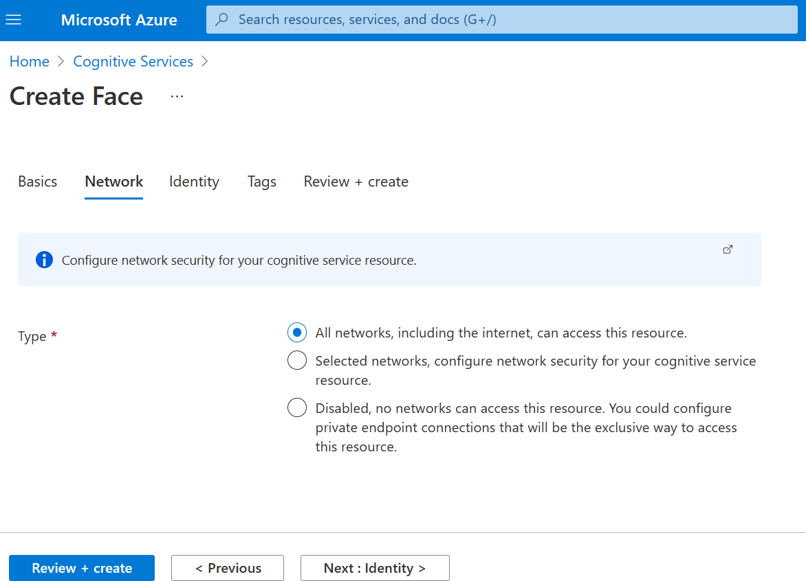
Azure Cognitive Service – Create FACE Api (Continued..)

Slide 10
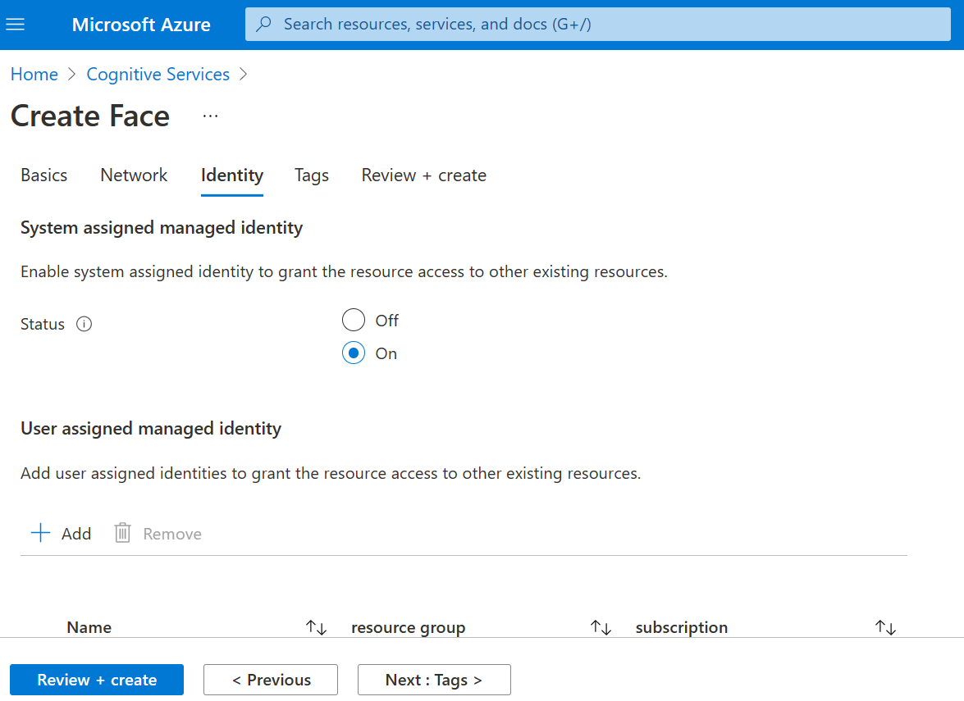
Azure Cognitive Service – Create FACE Api (Continued..)

Slide 11
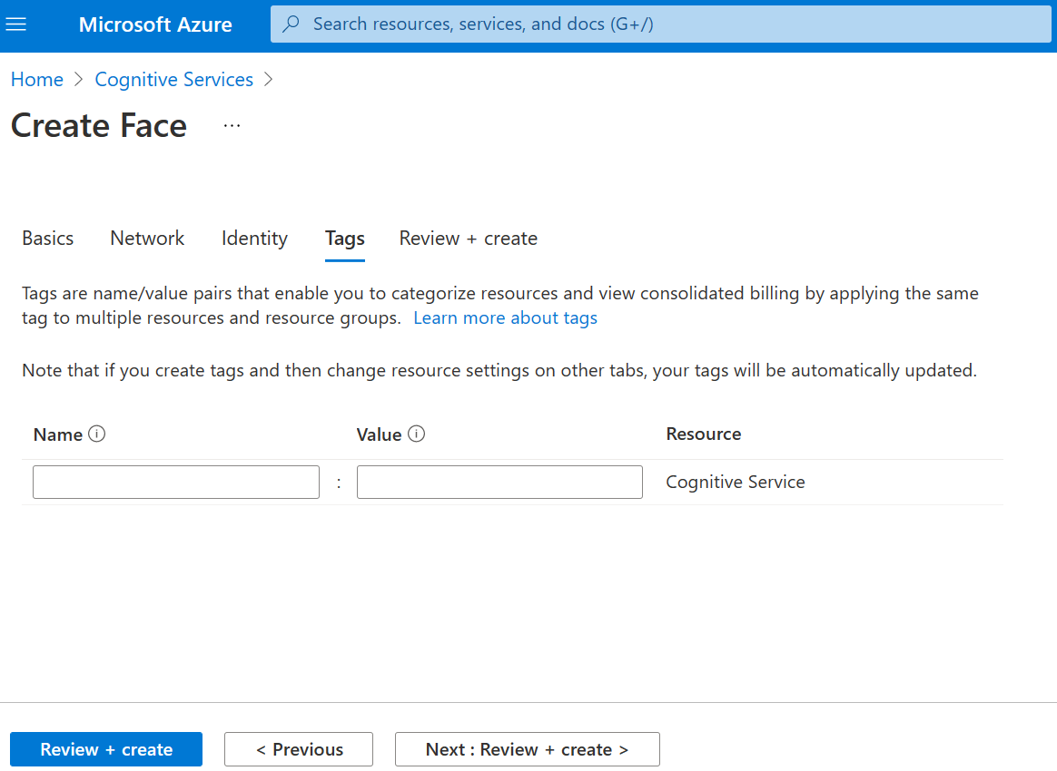
Azure Cognitive Service – Create FACE Api (Continued..)

Slide 12
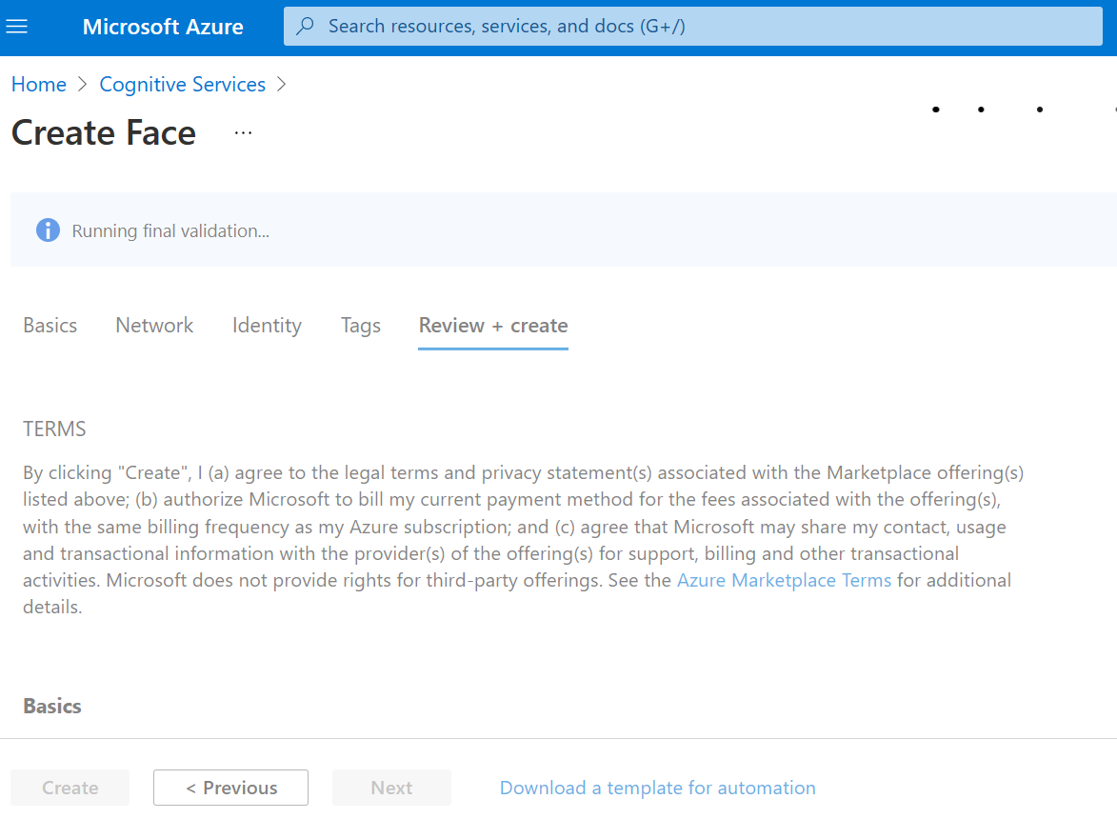
Azure Cognitive Service – Create FACE Api (Continued..)

Slide 13
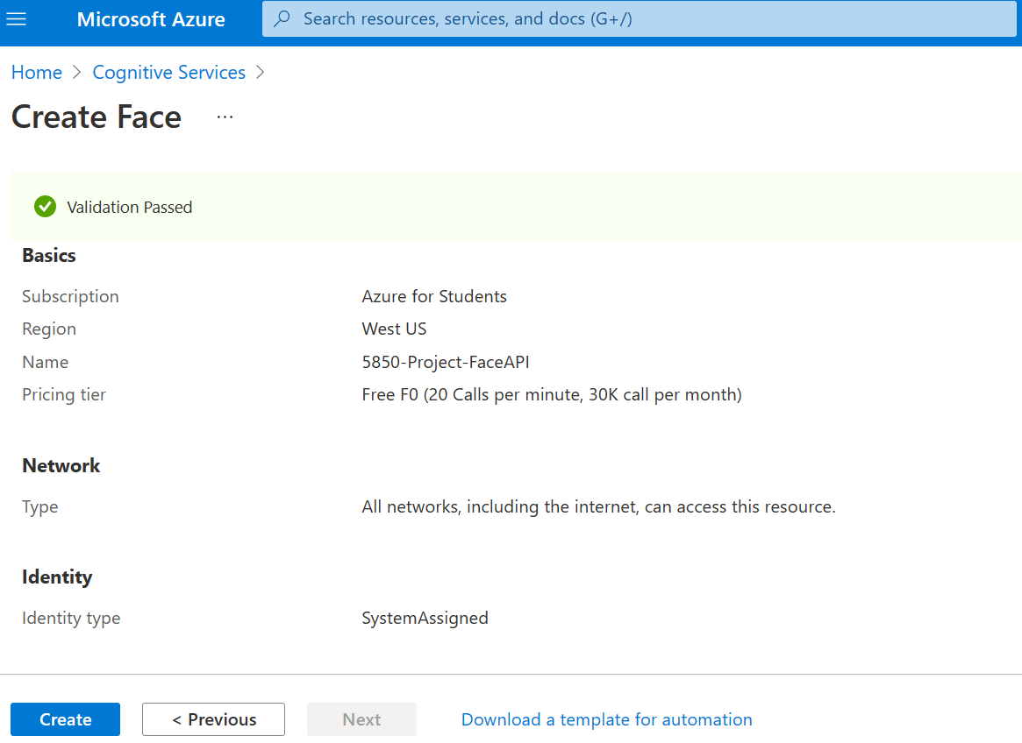
Azure Cognitive Service – Create FACE Api (Continued..)

Slide 14
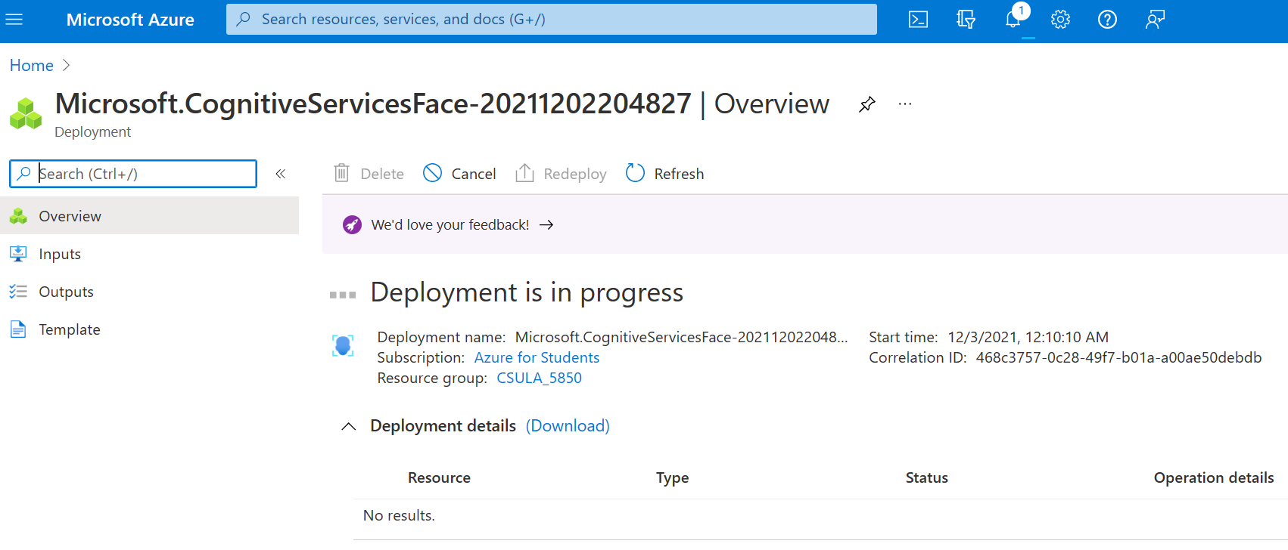
Azure Cognitive Service – Create FACE Api (Continued..)

Slide 15
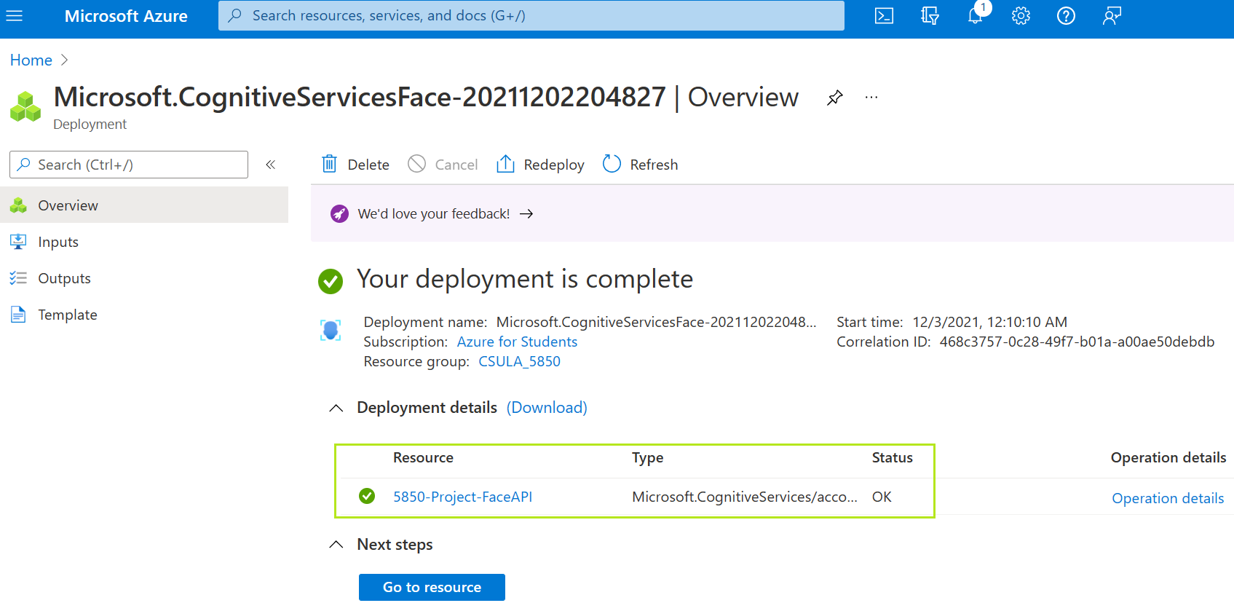
Azure Cognitive Service – Create FACE Api (Continued..)

Slide 16
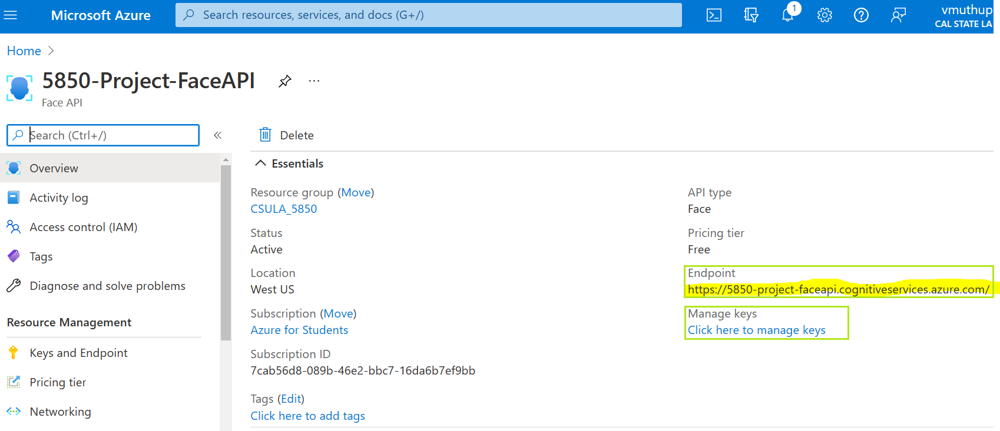
Retrieve FACE Api Endpoint and Key

Slide 17
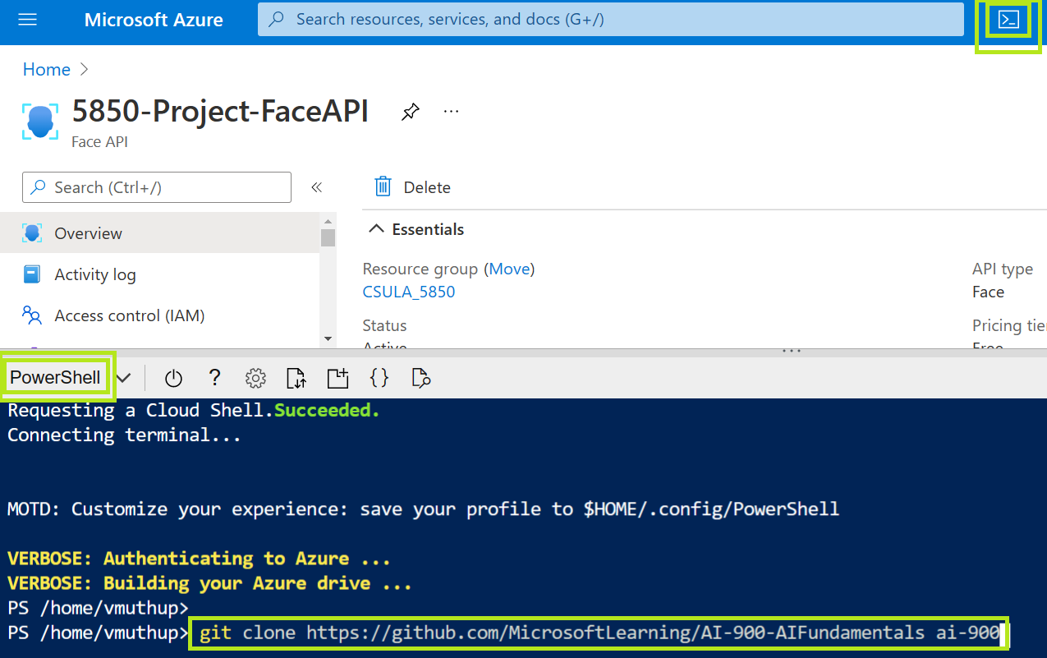
Launch Azure PowerShell and download GitHub Code

Slide 18
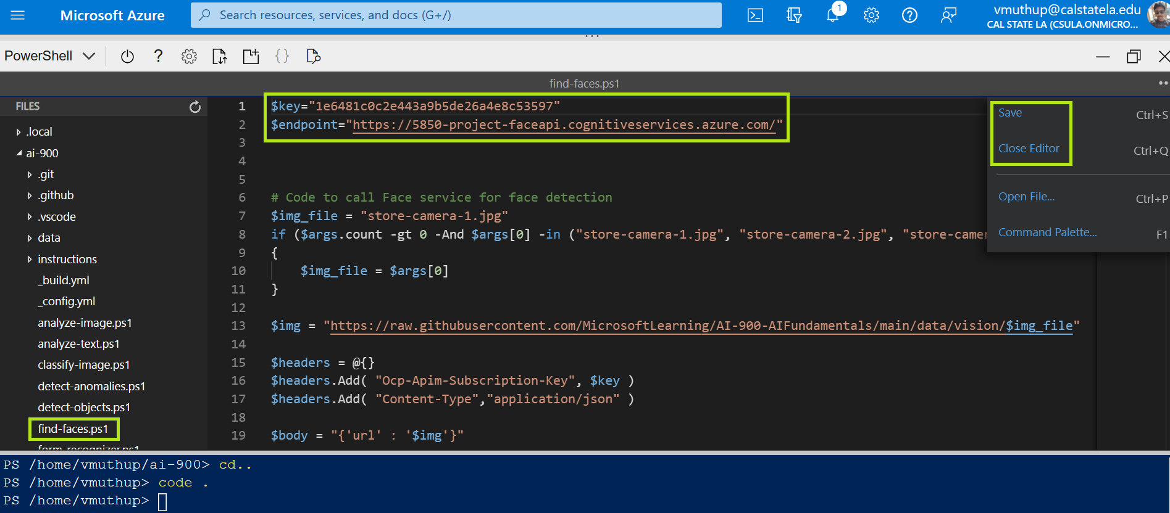
Configure the Application using PowerShell Editor

Slide 19



Azure AI Vision Face Analysis – Input Images
Store-Camera-1.jpg
Store-Camera-2.jpg
Store-Camera-3.jpg

Slide 20
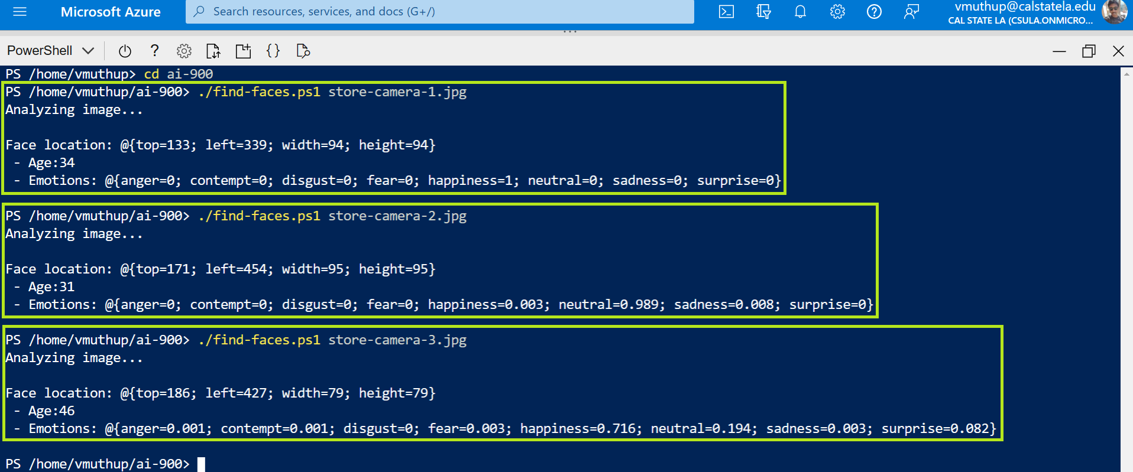
Azure AI Vision Face Analysis – Result (Loc, age, emotion)
Review the details of the faces found in the image, which include:
The location of the face in the image
The approximate age of the person
An indication of the emotional state of the person (based on proportional scores for a range of emotions)

Slide 21
Text Extraction from an Image – Azure “Form Recognizer”
There are 3 steps to demonstrate "Text Extraction from an Image".
1. Create a "Form Recognizer" Cognitive Service resource in Azure.
2. Run Azure PowerShell in Cloud.
3. From downloaded GitHub project, Configure and run the “Form-Recognizer.ps1” Python program.

Slide 22
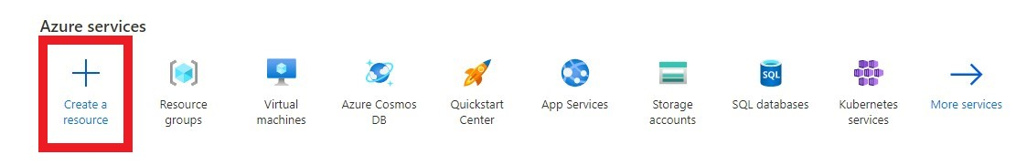
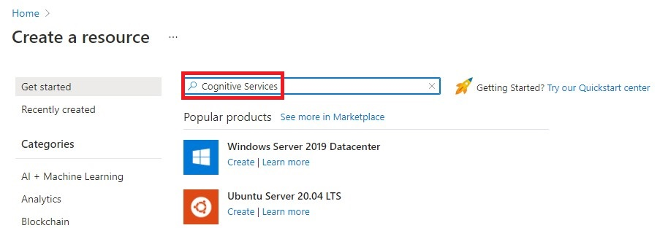
1. Create a "Form Recognizer" Cognitive Service resource in Azure.
Azure Cognitive Service – Create “Form Recognizer” API
1
2

Slide 23
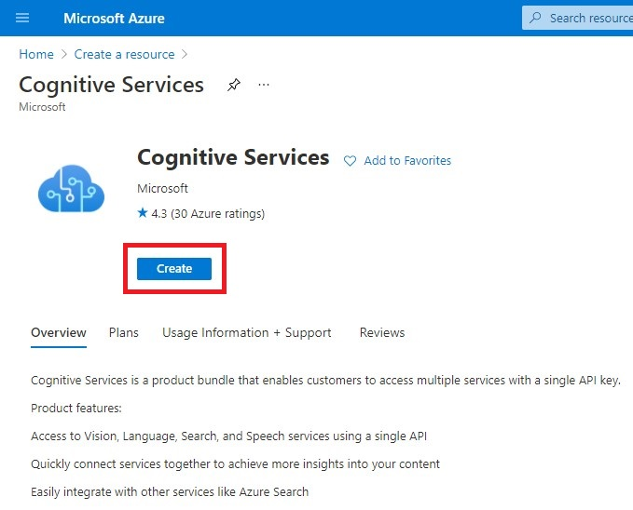
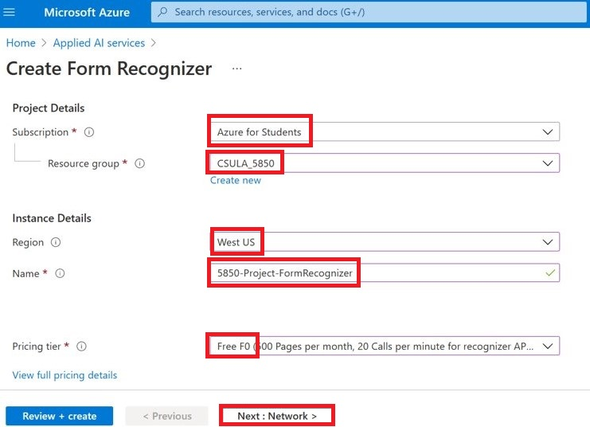
Azure Cognitive Service – Create “Form Recognizer” API (Continued..)
4
5
3
6
7
8
9

Slide 24
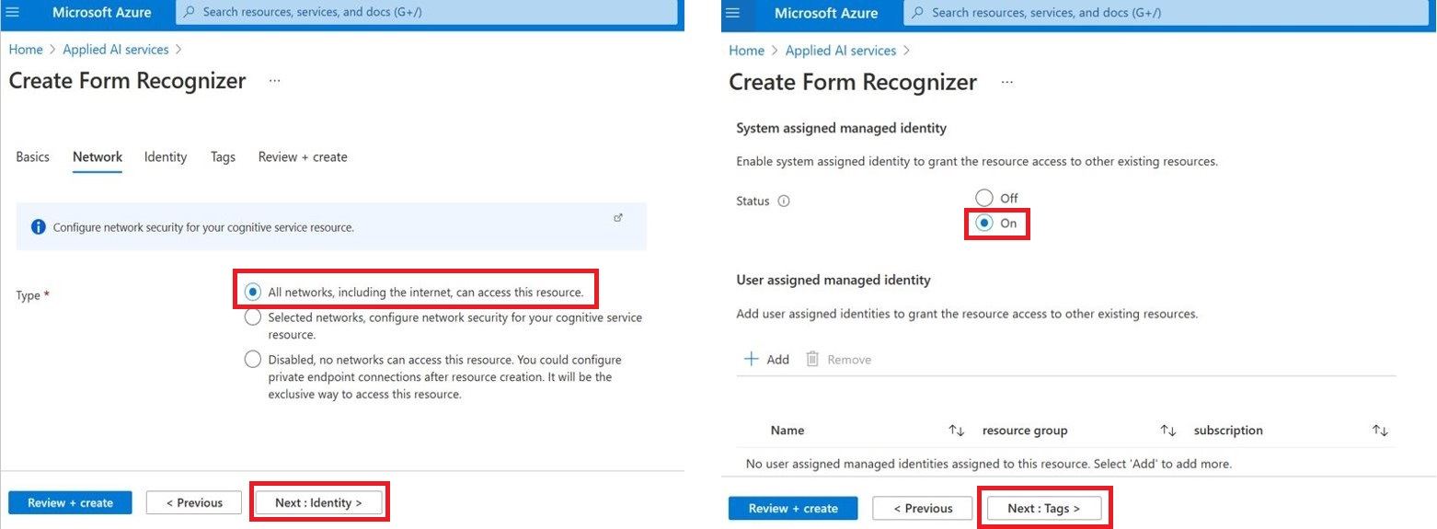
Azure Cognitive Service – Create “Form Recognizer” API (Continued..)
12
10
11
13

Slide 25
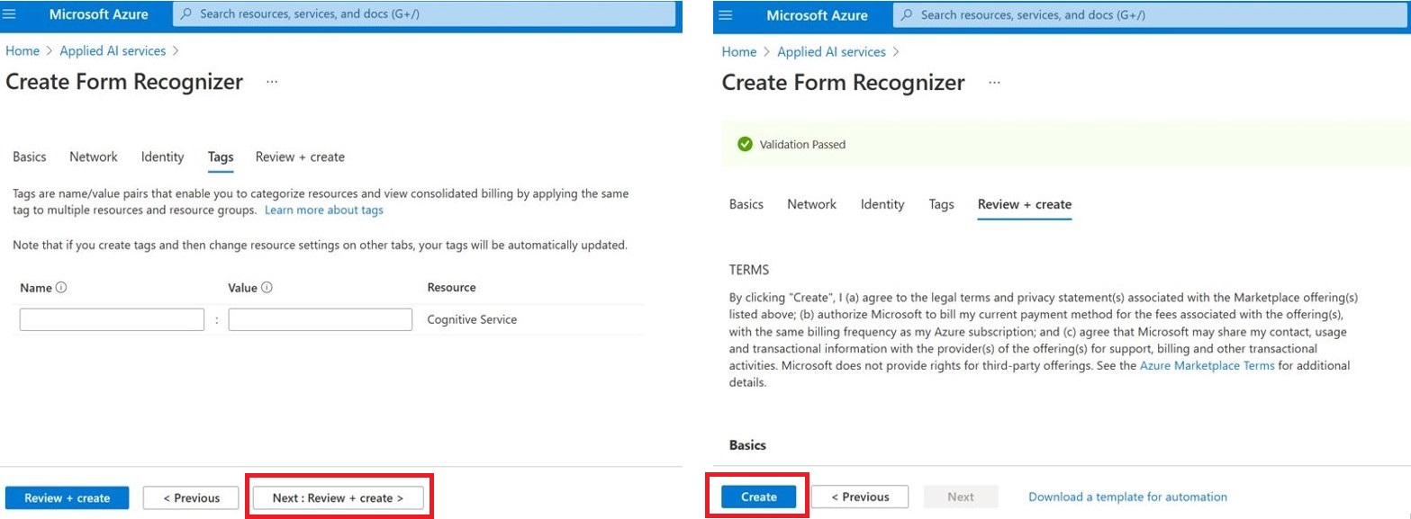
Azure Cognitive Service – Create “Form Recognizer” API (Continued..)
14
15

Slide 26
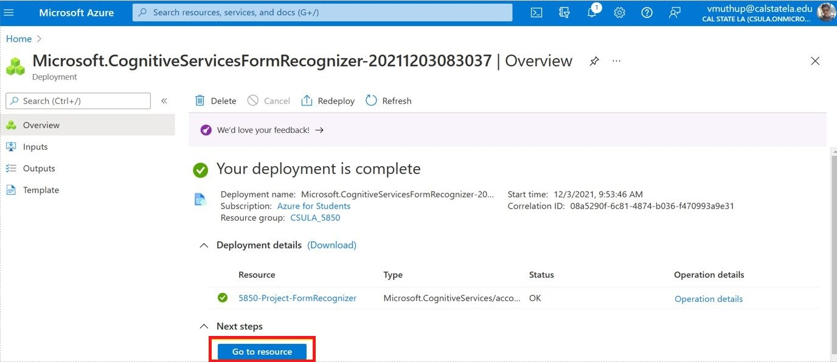
Azure Cognitive Service – Create “Form Recognizer” API (Continued..)
16

Slide 27
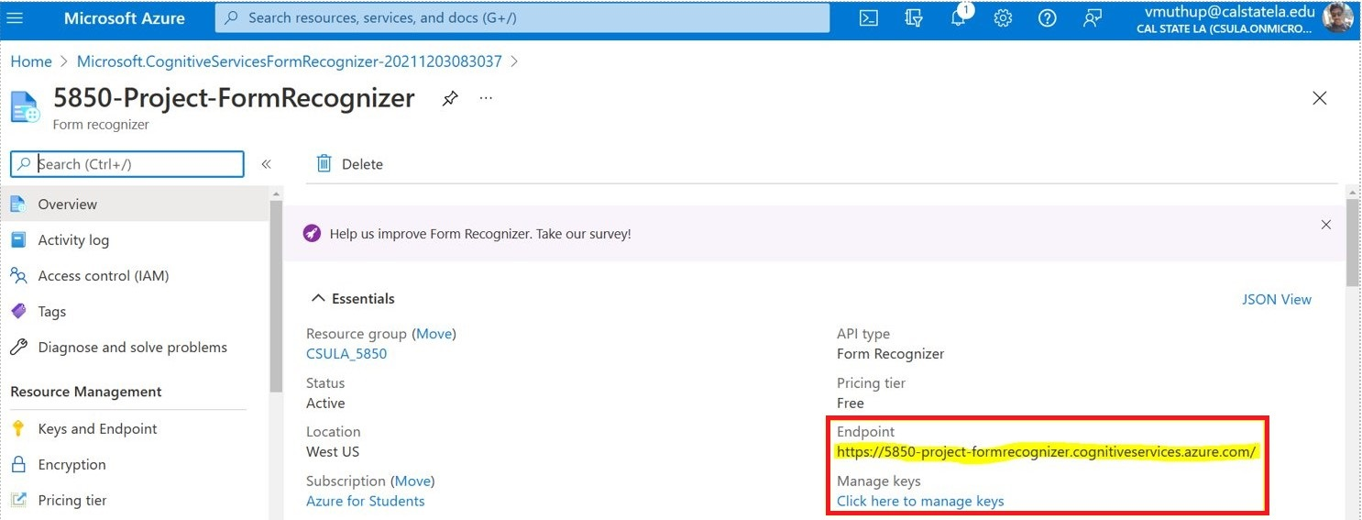
Azure Cognitive Service – Create “Form Recognizer” API (Continued..)
17

Slide 28
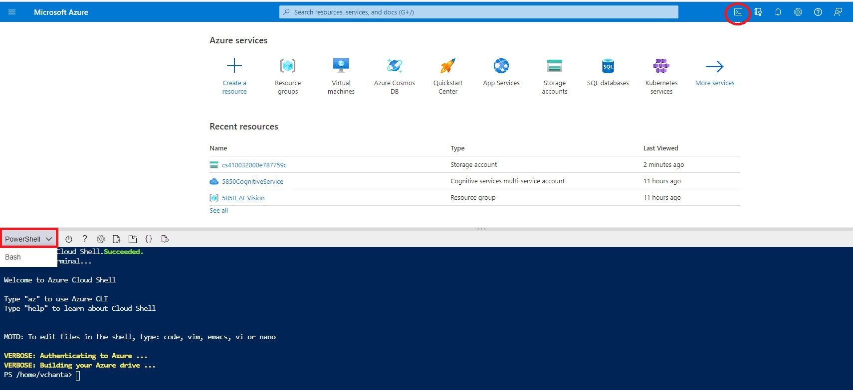
Launch Azure PowerShell in Cloud
1

Slide 29
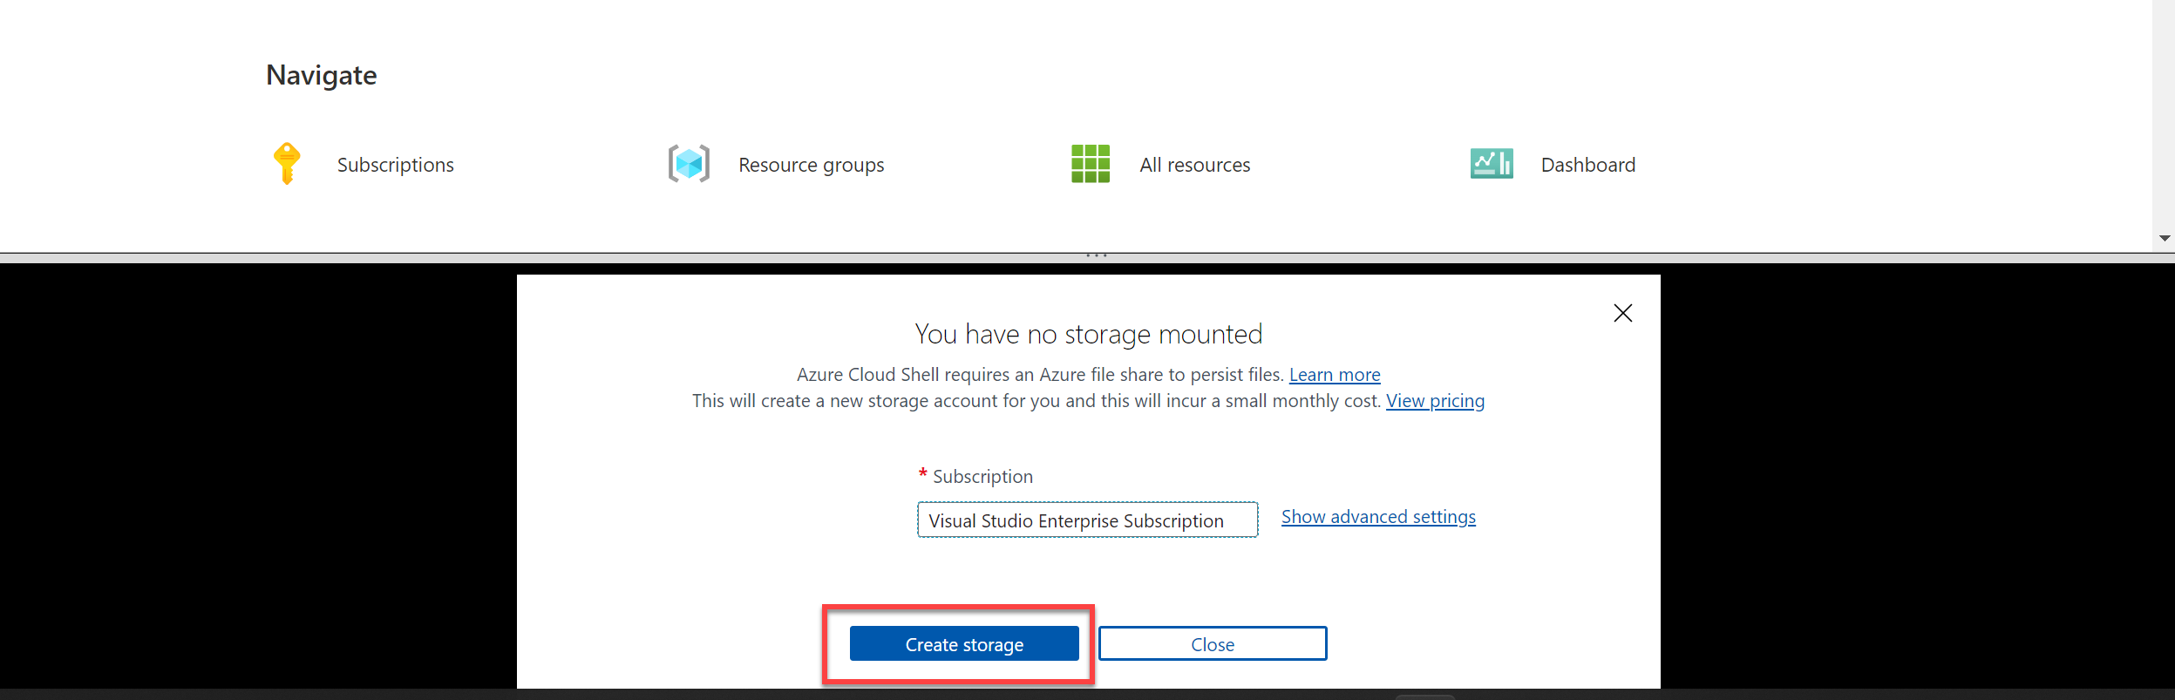
Launch Azure PowerShell in Cloud
1
2
3

Slide 30
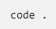
Configure and run the Python program
1
Run this command: To download the sample application and save the folder called ai-900
2
Run this command: To see all the files in your Cloud Shell storage

Slide 31
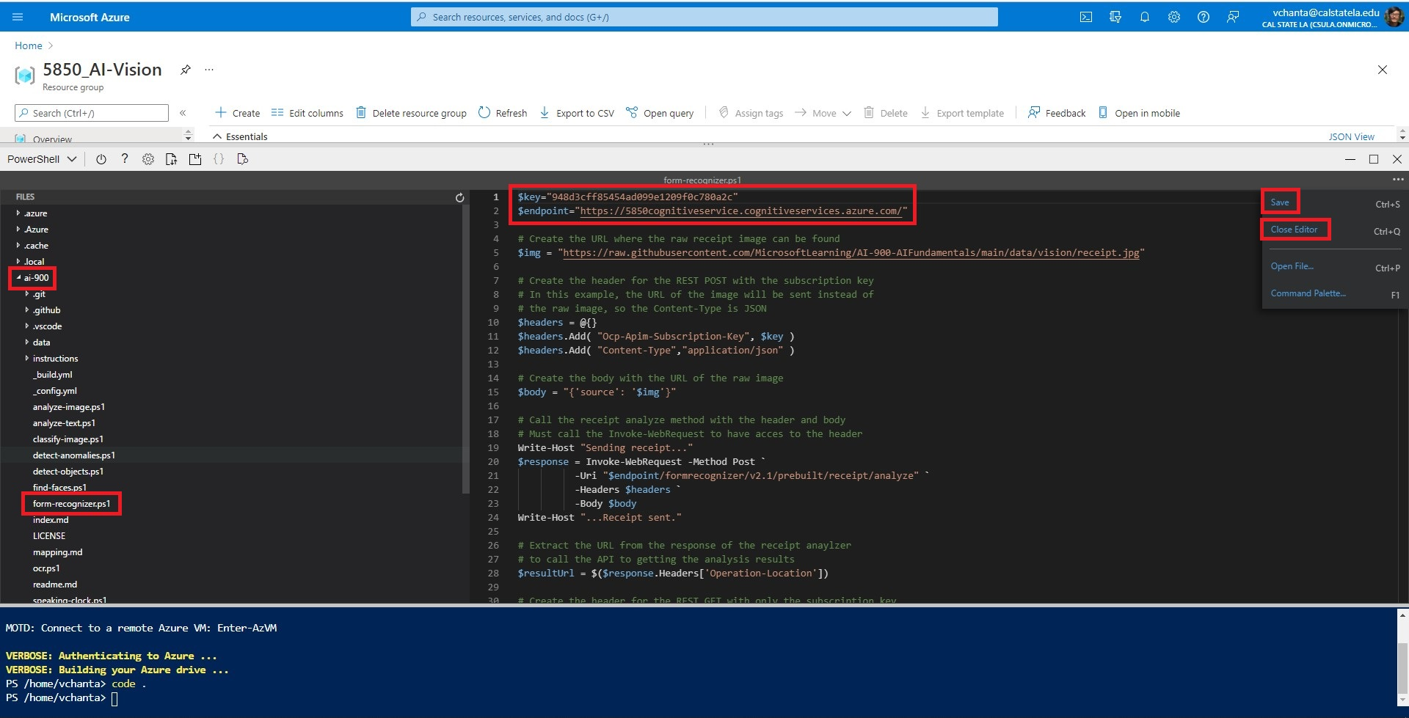
Configure and run the Python program
5
6
7
3
4

Slide 32
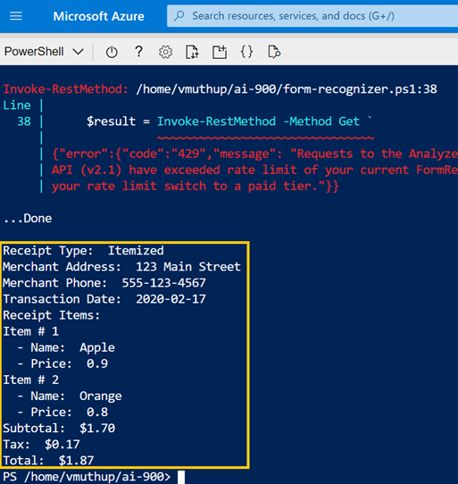
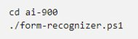
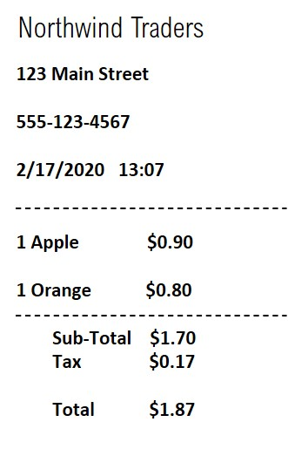
Form Recognizer – Output result
Run this command to execute Python Program: To read the text
Input Image of Receipt
Output

Slide 33




Technologies Used
https://github.com/MicrosoftLearning/AI-900-AIFundamentals

Slide 34
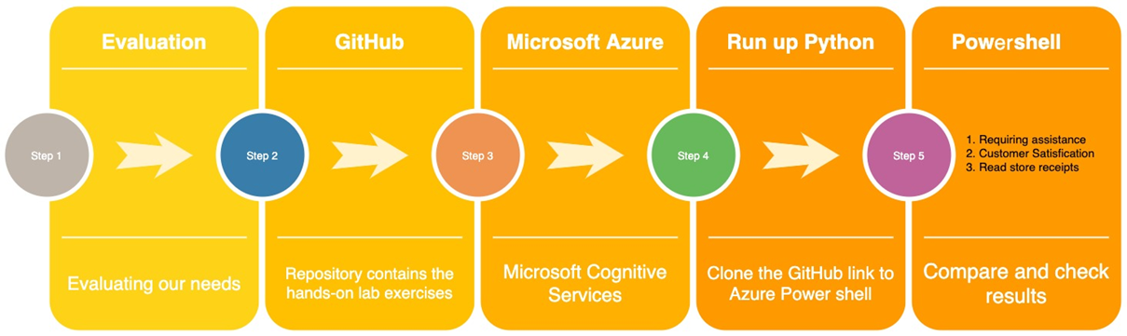
Technical Architecture

Slide 35













Path to Microsoft Azure AI 900 Certification​
Microsoft Azure AI Fundamentals
FINAL
Certification
STEP 03
Exam
STEP 02
exam preparation
and schedule
STEP 01
FREE Microsoft
Azure Virtual Training Day

Slide 36
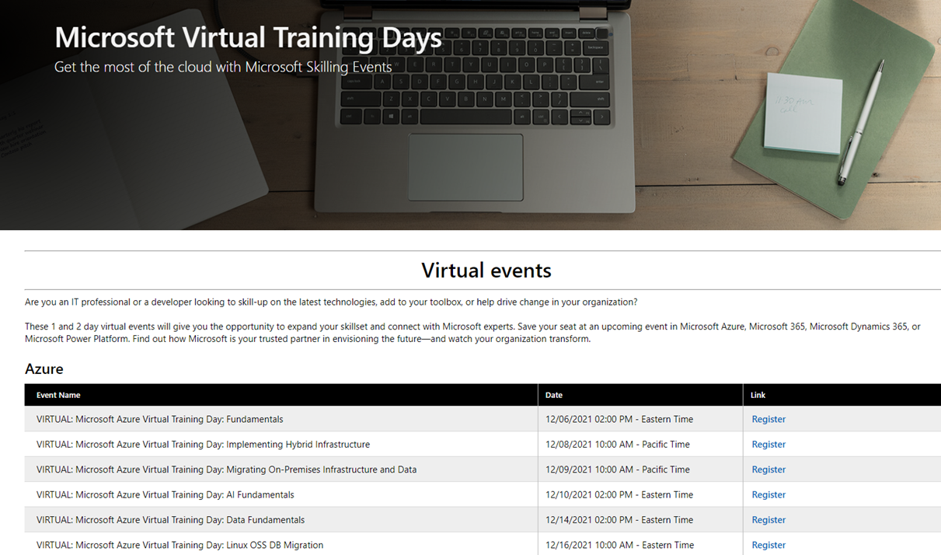
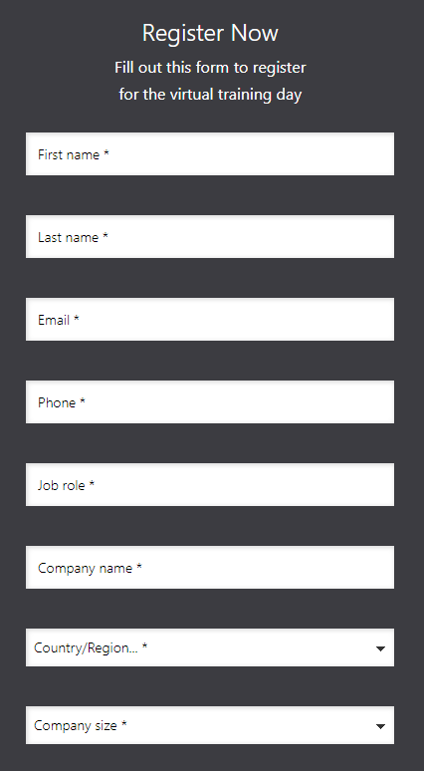
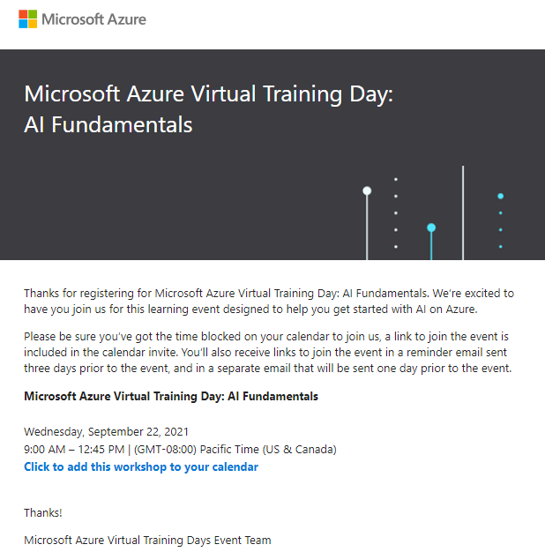
Microsoft Virtual Training Days – AI 900 Registration

Slide 37
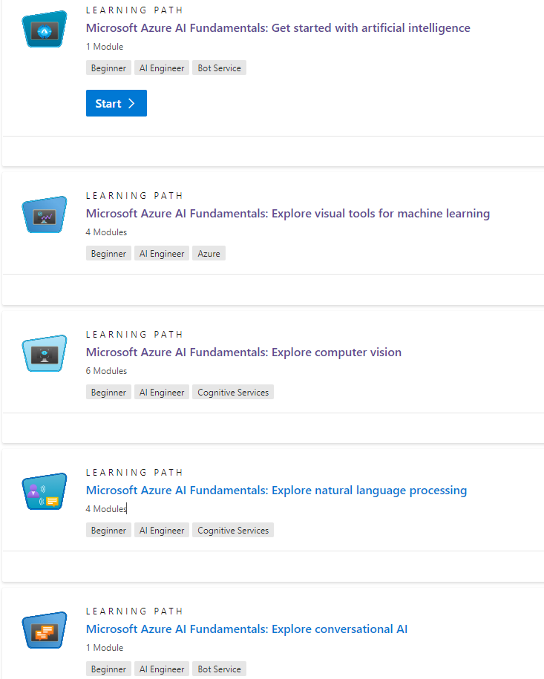

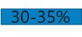
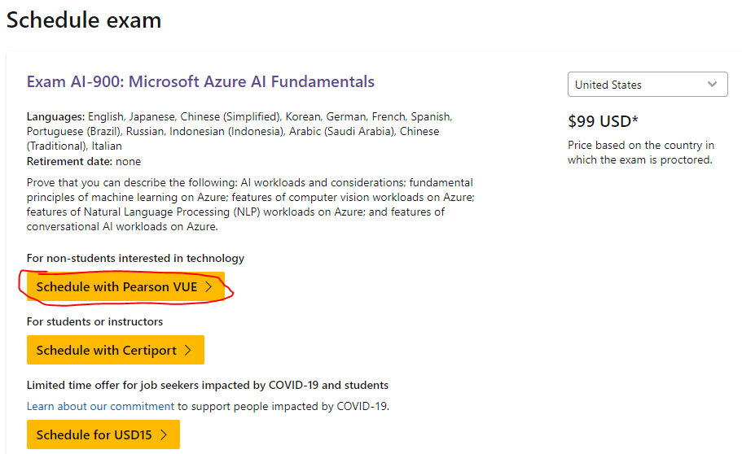
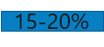
AI 900 – Study Topics and Schedule Exam
https://docs.microsoft.com/en-us/learn/certifications/exams/ai-900?tab=tab-learning-paths

Slide 38

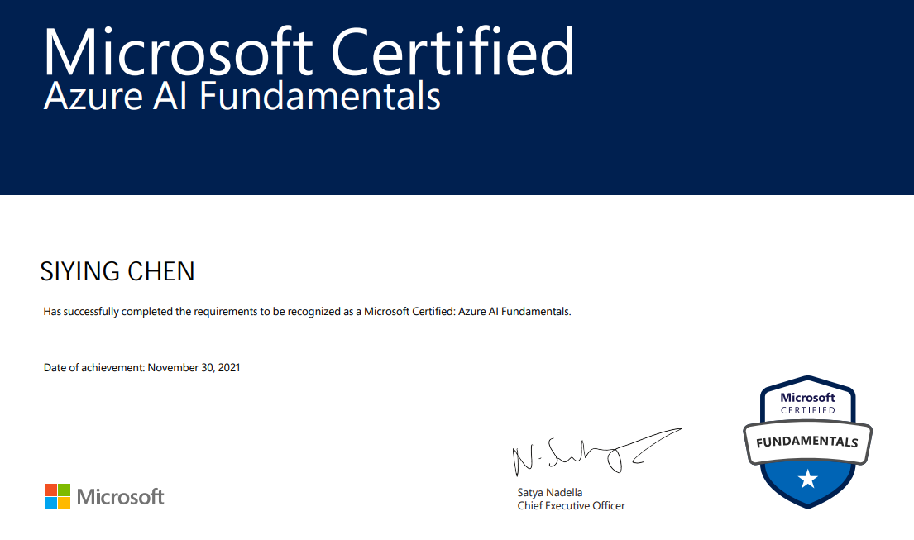
AI 900 – Pass Exam to get Certificated

Slide 39


